Slide 1
8.2 Cell Reproduction and Growth

Slide 2
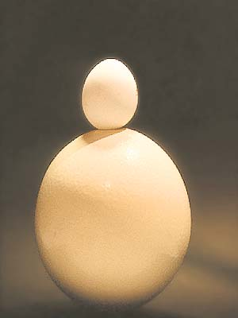
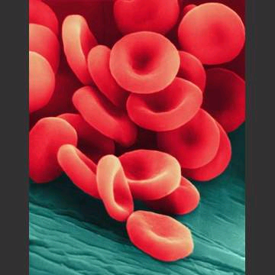
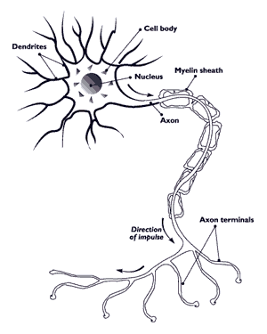
All organisms come from one cell
Largest: Ostrich Egg
Smallest: Red Blood Cell
Longest: Nerve Cell

Slide 3
Where do cells come from?
Another cell:
  Asexual Reproduction
  Exact copy of the cell
A combination of cells:
  Sexual Reproduction
  Male and Female sex cells combine
  Genes of both parents determine traits

Slide 4
Cell Size Limitations
Enough surface area to let materials in and out
  Diffusion takes time to reach all organelles
  In: water, glucose, oxygen
  Out: water, urea, carbon dioxide
Function: Depends on the type of cell
  Ex: nerves (long), RBCs (small)

Slide 5
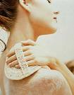
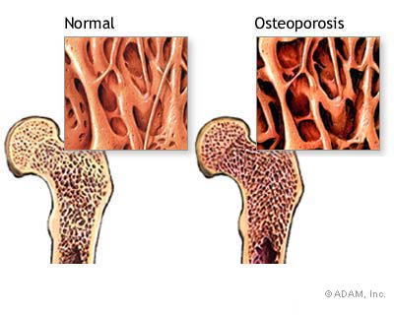
When do cells divide?
Some divide faster than others
  Skin cells: 25 million/sec. (created and destroyed)
  Bones?
  Nerves?
  Growing: more created than destroyed
  Repair: Getting cut (bleeding), bruises, sick

Slide 6
Role of Chromosomes
Chromatin coils into chromosomes during cell division (mitosis)
Chromosomes carry the genetic info. (DNA)
  DNA → Chromatin → Chromosomes
  Humans have 46 chromosomes
    Do our cells reproduce sexually or asexually?

Slide 7
Cell Cycle
Sequence of growth and division of a cell
  Interphase – growth phase
  Mitosis- division phase

Slide 8
Interphase
3 parts:
  Growth in size
  DNA Synthesis- copies its genetic material
  Growth period- prepares for division (protein)

Slide 9
Mitosis- 4 phases
Cell division is continuous (phases blend)
PMAT
  Prophase
  Metaphase
  Anaphase
  Telophase

Slide 10
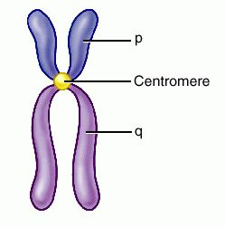
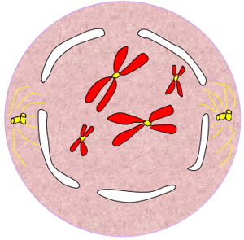
Prophase
First and longest phase of division
Chromatin coils into chromosomes
Sister chromatid (exact copies of a chromosome) attached by a centromere
Nuclear envelope disintegrates
Centrioles migrate (animal)/
spindle forms

Slide 11
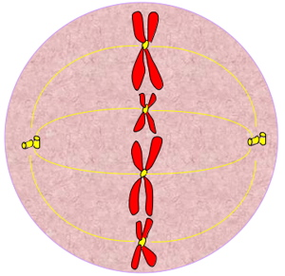
Metaphase
Second and shortest phase
Chromosomes align on the metaphase plate
Spindle fibers attach to each sister chromatid

Slide 12
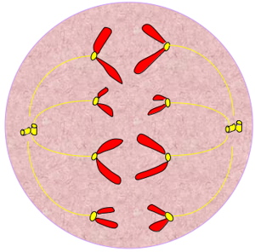
Anaphase
Third phase
Spindle fibers pull sister chromatid apart
  Chromatid are now chromosomes
Centromere breaks apart

Slide 13
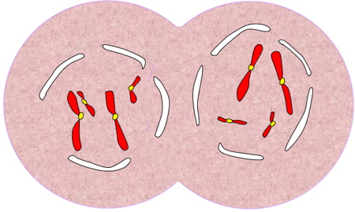
Telophase
Final division phase
Chromosomes reach opposite ends of the cell
Spindle breaks down /chromosomes uncoil
Nuclear envelope forms around chromosomes

Slide 14
Cytokinesis
Division of the Cytoplasm
Plants
  form a cell plate → cell wall
Animals
  cleavage furrow- plasma membrane pinches

Slide 15
Results of Mitosis
Two identical nuclei → cells
Unicellular- remain as single cells
Multicellular- groups of cells working together
  Tissue→ Organ→ Organ System→ Organism
  Review

Slide 16
8.3 Control of cell cycle
Enzymes promote or inhibit cell division
  Directed by genes (growth hormone)
Gene- segment of DNA controlling protein production
  Eye color (controls protein for blue or brown)
  Skin color (controls level of melanin)

Slide 17
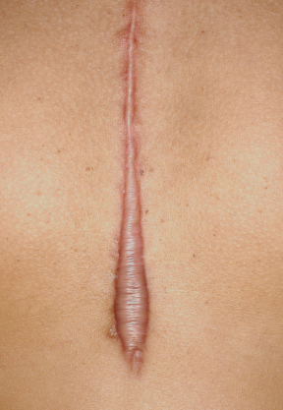
Contact inhibition
When cells touch, they stop dividing
Form a layer, not a pile of cells

Slide 18
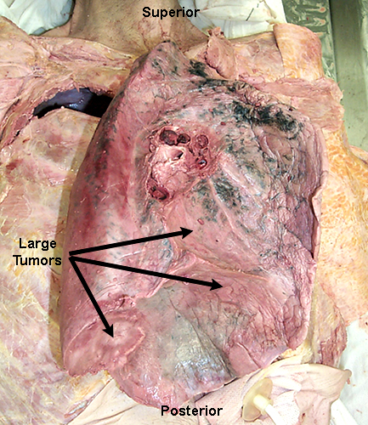
Cancer
Uncontrolled division of cells
Tumors:
  Malignant (cancerous)
  Benign (stops growing)
Metastasis- spreading of cancer through body
  Examples

Slide 19
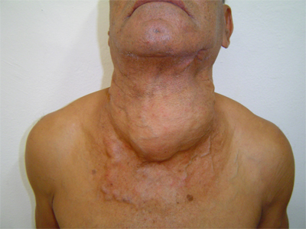
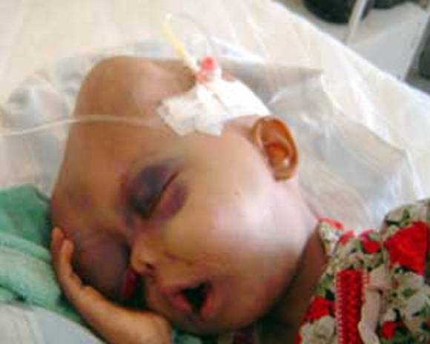
Causes of Cancer
Genetic
  Runs in the family
Environmental
  Smoke, pollution, radiation

Slide 20
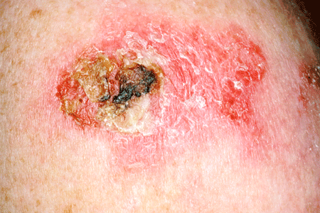
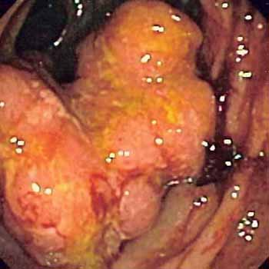
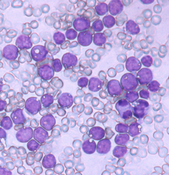
Types of Cancer
Carcinomas
  internal or external coverings
Sarcomas- bone or muscle
Leukemia- blood or bone marrow
Lymphomas
  spleen and lymph nodes

Slide 21
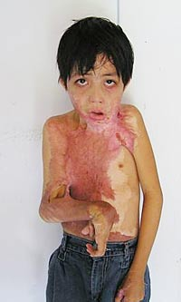
Replacement Skin

